Slide 1
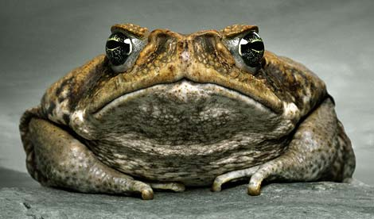
TOADALLY DUDE

